Slide 1
https://bit.ly/CHSS-DD

Slide 2
Agenda
Eligibility
Budget
Connect Community Forum
Application portal
Q & A

Slide 3
Eligibility
South and Southeast Asian nationals holding a Ph.D. or Master’s degree or equivalent who are—or will be—engaged in the academic profession in South and Southeast Asia.
Southeast Asia (e.g., Cambodia, Lao PDR, Myanmar, Timor-Leste, Indonesia, the Philippines, Thailand, and Vietnam)
South Asia (e.g., Afghanistan, Bangladesh, Bhutan, Pakistan, Nepal, Sri Lanka, and India). When evaluating proposals from Indonesia, the Philippines, Thailand, Vietnam, and India, the review committee will prioritize applicants who come from regions and/or institutions with resource and infrastructure constraints.
Scholars, students, independent researchers, and public intellectuals, who are based in low- and lower medium-income countries as well as those who come from and may be living in post-conflict areas or areas where conflicts are still ongoing.
AAS membership is not a requirement.

Slide 4
We also encourage collaborative projects, especially those that partner scholars from under-resourced institutions with colleagues at institutions that offer more resources and infrastructure to support their work.
In addition, the CHSS grant program encourages individual and group projects (such as those bringing senior and junior scholars together) that will explore the mainstreamed subjects of
Development
Democracy
Human Rights
Gender
The Environment
Forest Conservation in the Philippines $−$ Apply for the FFP Grant here

Slide 5
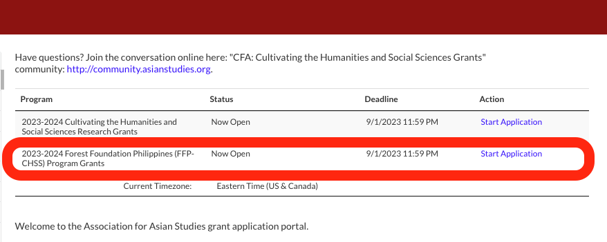
FFP Grants
The FFP grant program encourages projects related to forest conservation and restoration, forest communities and sustainable livelihoods, indigenous knowledge systems, forest policy, governance, (counter)mapping forest landscapes, and other approaches that foster knowledge co-creation and transdisciplinary knowledge-making in any discipline of humanities and social sciences.
Under-represented scholars, including indigenous scholars, women, and early-career researchers, especially from Palawan, Sierra Madre, Samar and Leyte, and Bukidnon and Misamis Oriental, are invited to apply.

Slide 6
Budget
Applicants to CHSS grants request $2,000 - $12,000 USD
Applicants to the FFP grants may request $2,000 - $9,000 USD
The proposed short- and long-term research grants should support the work of postdoctoral scholars, Ph.D., or Masters students who wish to undertake research essential for their thesis, dissertation. and/or book projects, or for manuscript revisions, conference papers, and journal articles.
Funding may be used for:
Research essential for postdoctoral scholars and Ph.D. and Master’s students thesis, dissertation, and/or book projects, or for manuscript revisions and journal articles in the humanities and social sciences.
Small scholarly seminars and pedagogical workshops.
Translation, curriculum development, and textbooks projects that facilitate the dissemination and implementation of the research results.
Documentary films and visual arts projects.
Funding may not be used for:
Travel and accommodation expenses to attend a professional conference.
The funding may not be used in conjunction with another research grant.

Slide 7
Allowable expenses (other than per diem)
SIDA 2023 per diem rates
https://www.skatteverket.se/privat/skatter/arbeteochinkomst/traktamente/utlandstraktamente.4.2b543913a42158acf800016035.html
Office supplies
Printing/copying/photocopying
Admission/fees to access research material
Workshop hosting supplies
Prorated costs of utilities
Equipment to conduct/record research
External storage drives
Subscriptions to Adobe, Microsoft Office, Online archival websites
Bank transfer fees
Previously budgeted contingency funds
Costs for services shall relate to activities performed, and costs for supplies shall relate to delivery and installation of goods, during the activity period. Signature of a contract, placing of an order, or entering into any commitment for expenditure within the activity period for future delivery of services or supplies after expiry of the activity period do not meet this requirement.
Costs incurred should be paid before the submission of the final reports. They may be paid afterwards, provided they are listed in the final financial report together with the estimated date of payment.
An exception is permitted for costs relating to final reports including cost verification, audit and final evaluation of the project/core activities, which may be incurred after the activity period.

Slide 8
Allowable expenses (continued)
They must be indicated in the estimated overall budget of the project/core activities and further detailed in the approved work plan and budget.
They must be necessary for the implementation of the project/core activities.
They are identifiable and verifiable and being recorded in the accounting records.
Compensation costs claimed to the project/core activities must be recorded throughout the duration of the project/core activities in a systemized way and verified by supporting documentation, and they must be reasonable, justified and comply with the requirements of sound financial management, in particular regarding economy and efficiency.

Slide 9
Unallowable expenses
Debts, and in the case of projects, also debt service charges (interest)
Provisions for losses or potential future liabilities
Items already financed from another agreement with SIDA or another financing agency
Purchases or construction of real estate (land or buildings)
In the case of projects, currency exchange losses
Credits to third parties
Travel costs for business or first class
Extra allowances, such as sitting allowances, or equivalent in order to finance allowances for participating staff/invited speakers/participants of workshops or the build-up of reserves.

Slide 10
Unsure about cost eligibility?
Apply sound reasoning before considering accepting the cost.
Prepare to provide justification if the eligibility of the expense is seemingly unreasonable, costly, excessive in time, or other factors that a third-party would question without context.
Unexpected project related expenses are anticipated during your research. Each additional, unidentified expense may not require approval. If you are confident with the validity, applicability, and necessity of the cost and it can be reasonably introduced to your budget, avoid causing undue delays in project activities.
If you are still unsure of the eligibility, contact the AAS via the Community Forum Group.

Slide 11
How to Classify Professional Services
Professional expenses range from services provided by an established business, to individuals in the field providing a service in support of your research/project.
For example:
Knowing that paying informants is not eligible for reimbursement, I can consider what – if any – services can be offered in support of my research. As I am in an area where I am not entirely familiar with the language, an individual with the relevant language expertise may provide translation services to assist me in my research/fieldwork.
Examples such as the above may be considered as an eligible professional service expense, and an invoice may be generated or requested from the individual.

Slide 12
At a minimum, ensure that invoices clearly show:
Your name and date
Name of individual/business name
Detailed explanation of service
Total amount in original currency, exchange rate (11 Jan 23), and total amount in USD
Signed by you and the individual
Invoices are submitted in English. Original invoices are anticipated to be in other languages. Provide a translated copy for CHSS project reviews.
Likely, invoices may not be readily available from individuals providing services in the field. Creating a template to use for professional services is highly encouraged.

Slide 13
Categorizing Expenses
Try not to overthink this process in an effort to reduce delays or holds in your research.
Key factors:
Where does this cost make the most sense? (if unsure, use Misc. page)
Do I have the funding, or anticipated funding in this category to support this cost?
Anticipated funding may derive from lowered costs of budgeted items, planning to remove unneeded expenses during the project, or other cost-saving strategies.
Unsure still? Apply sound reasoning, and/or ask the AAS via the Community Forum Group.

Slide 14
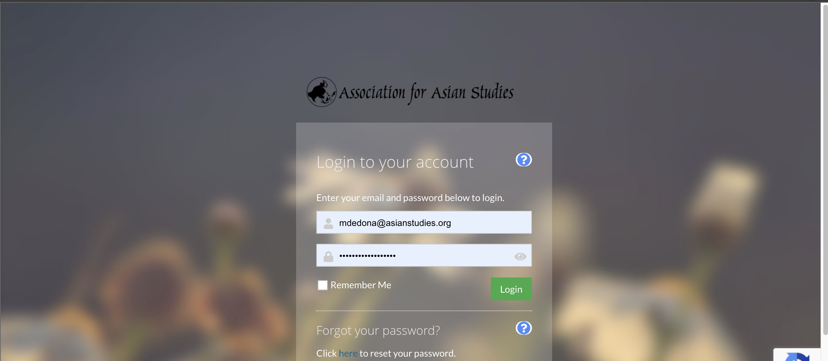
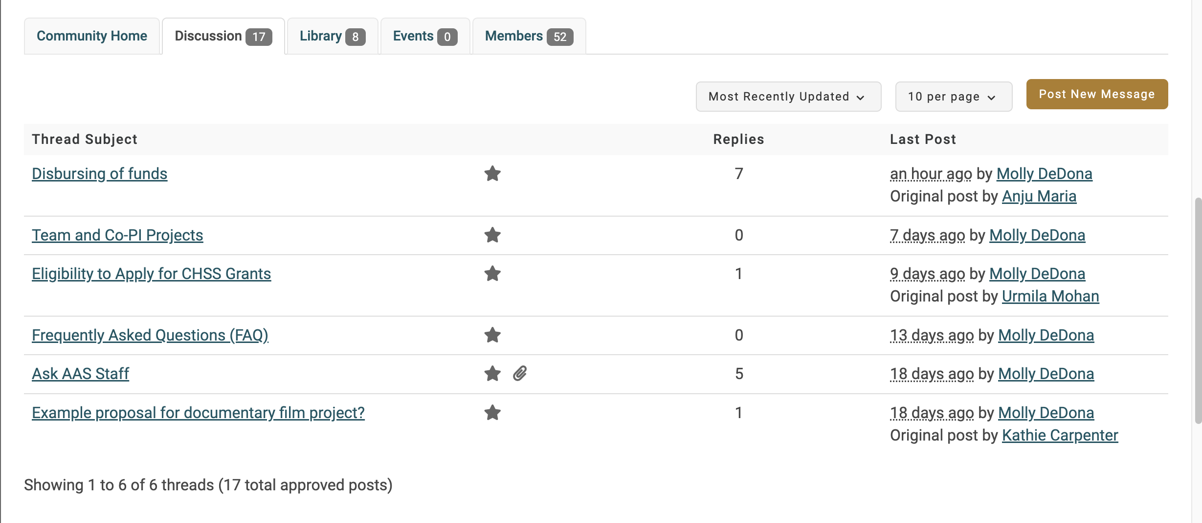
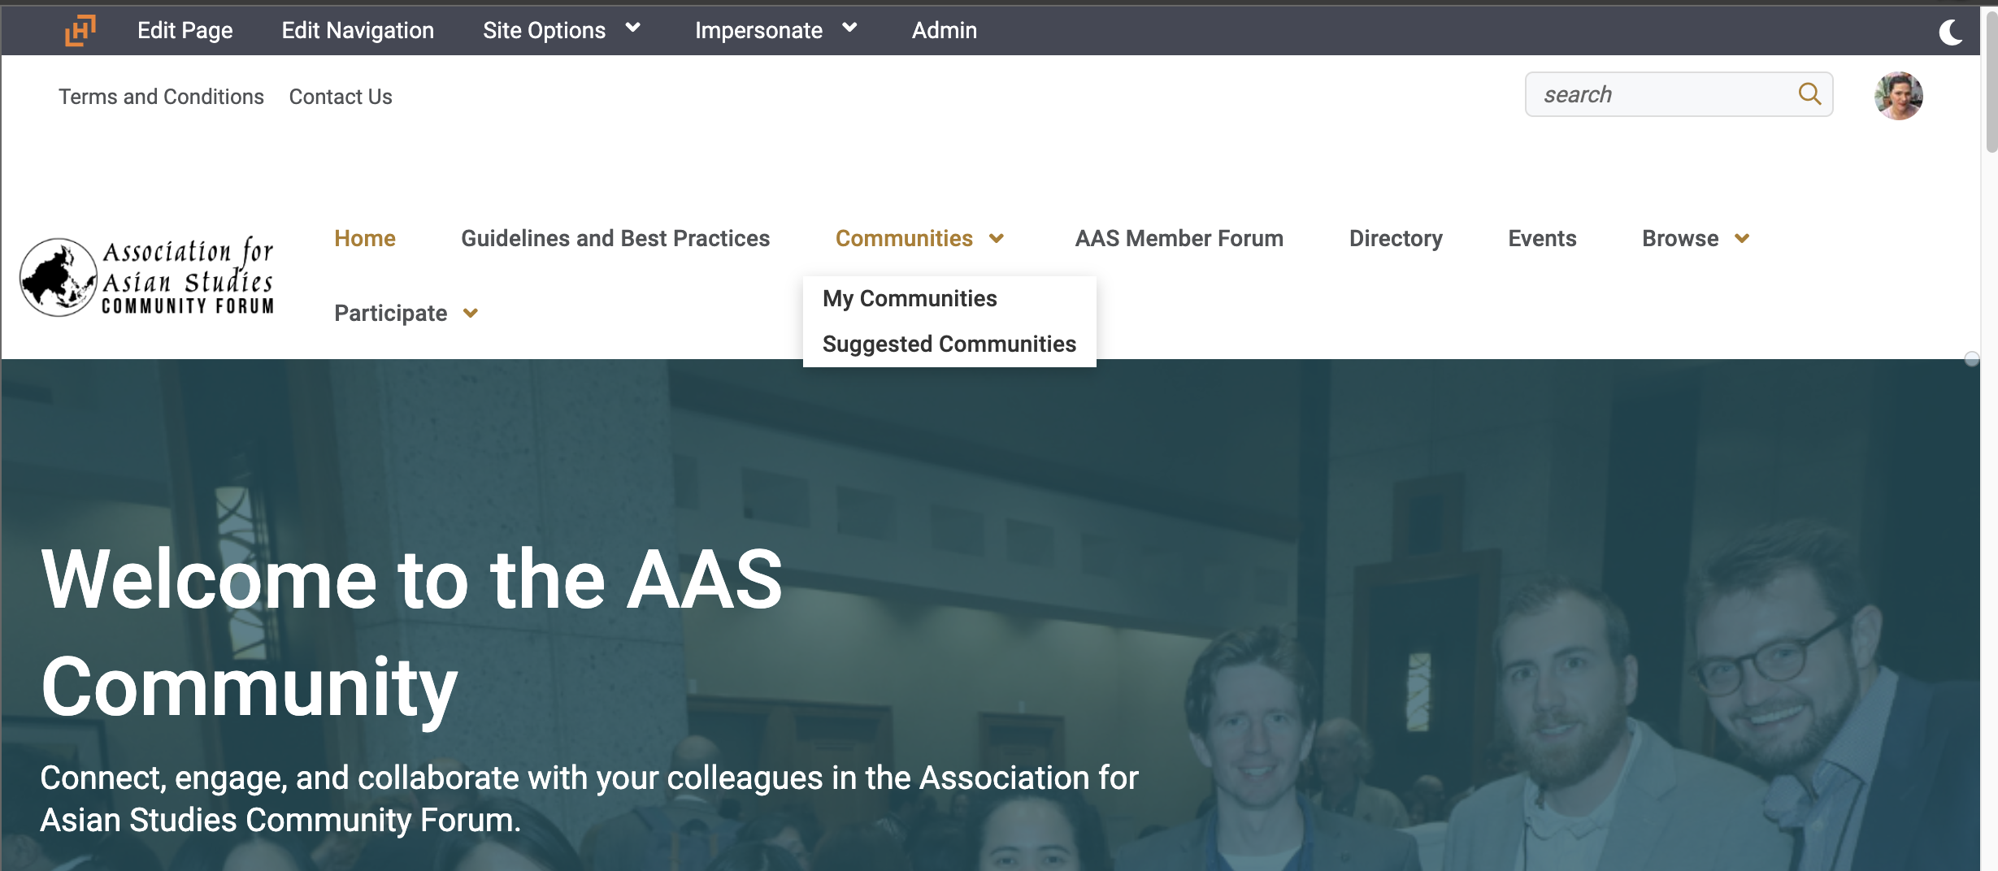
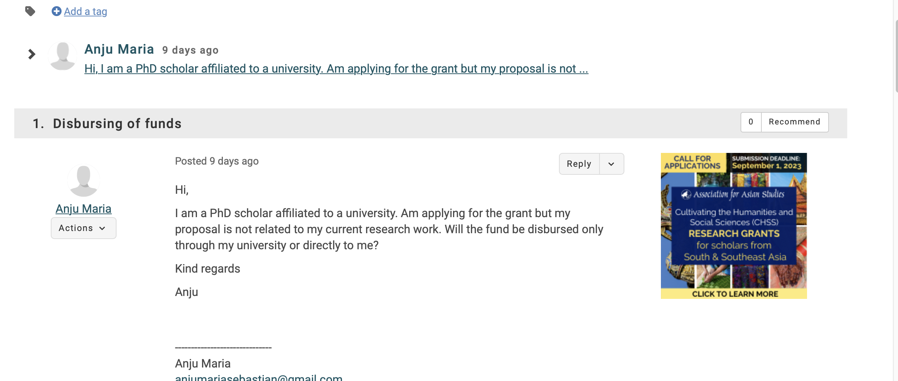
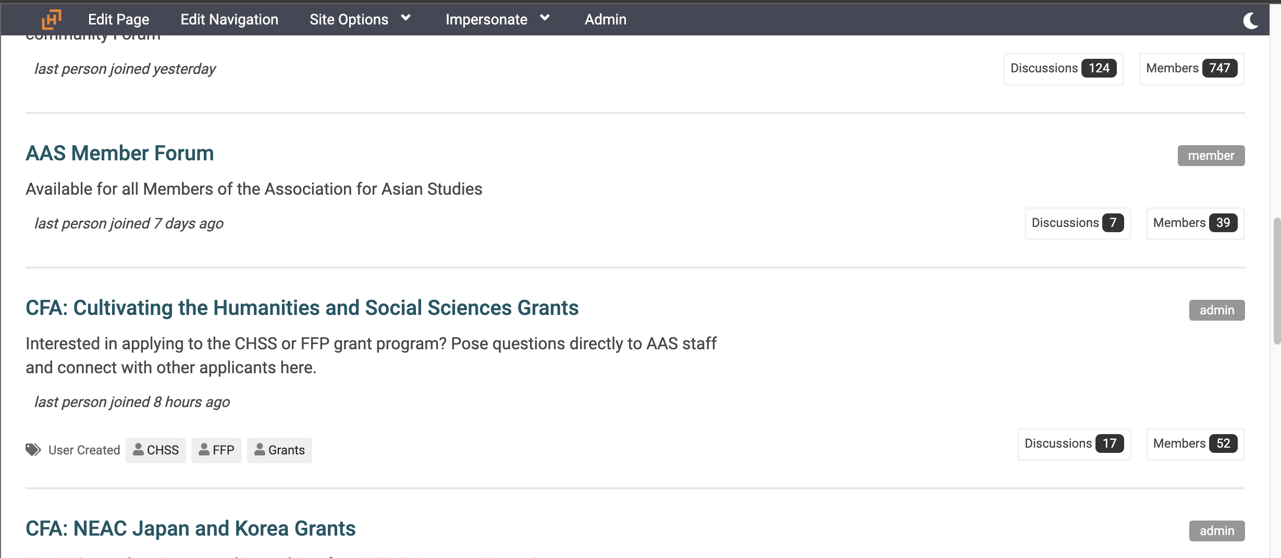
Connect Community Forum
Have additional questions? Please reach out to AAS staff via the community forum
Click "Log in and Participate"
Create an account or login (not the same as the application portal login)
Join the group
Post questions!
Notes:
The community forum group is available to members and non members. All you need is an aas online account login

Slide 15
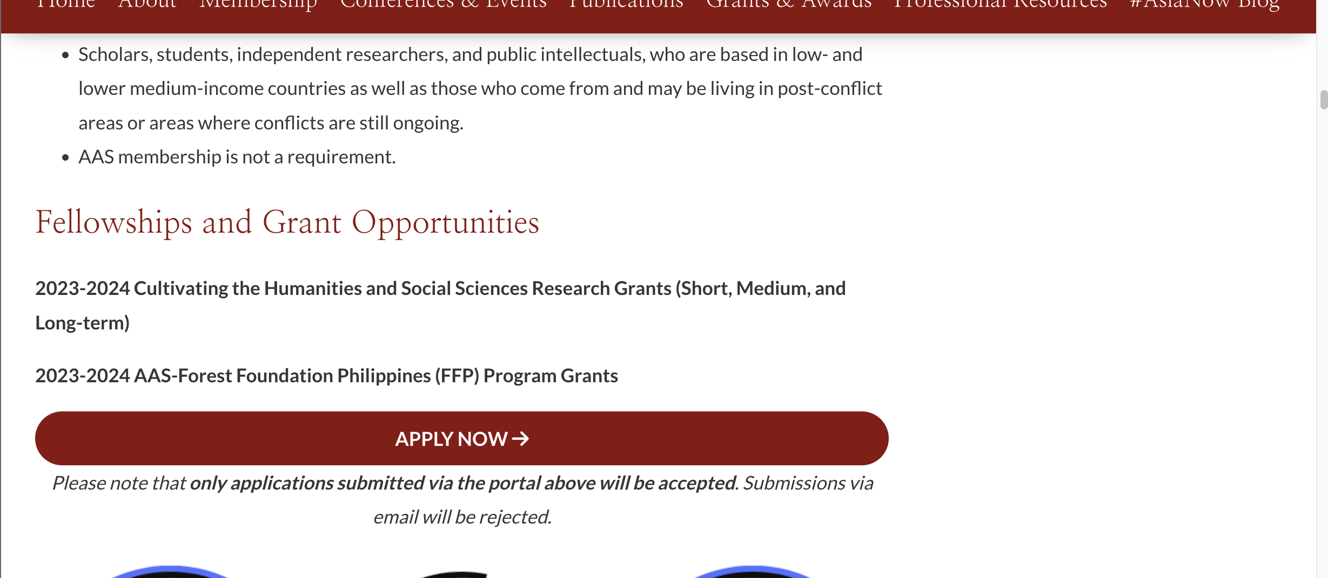
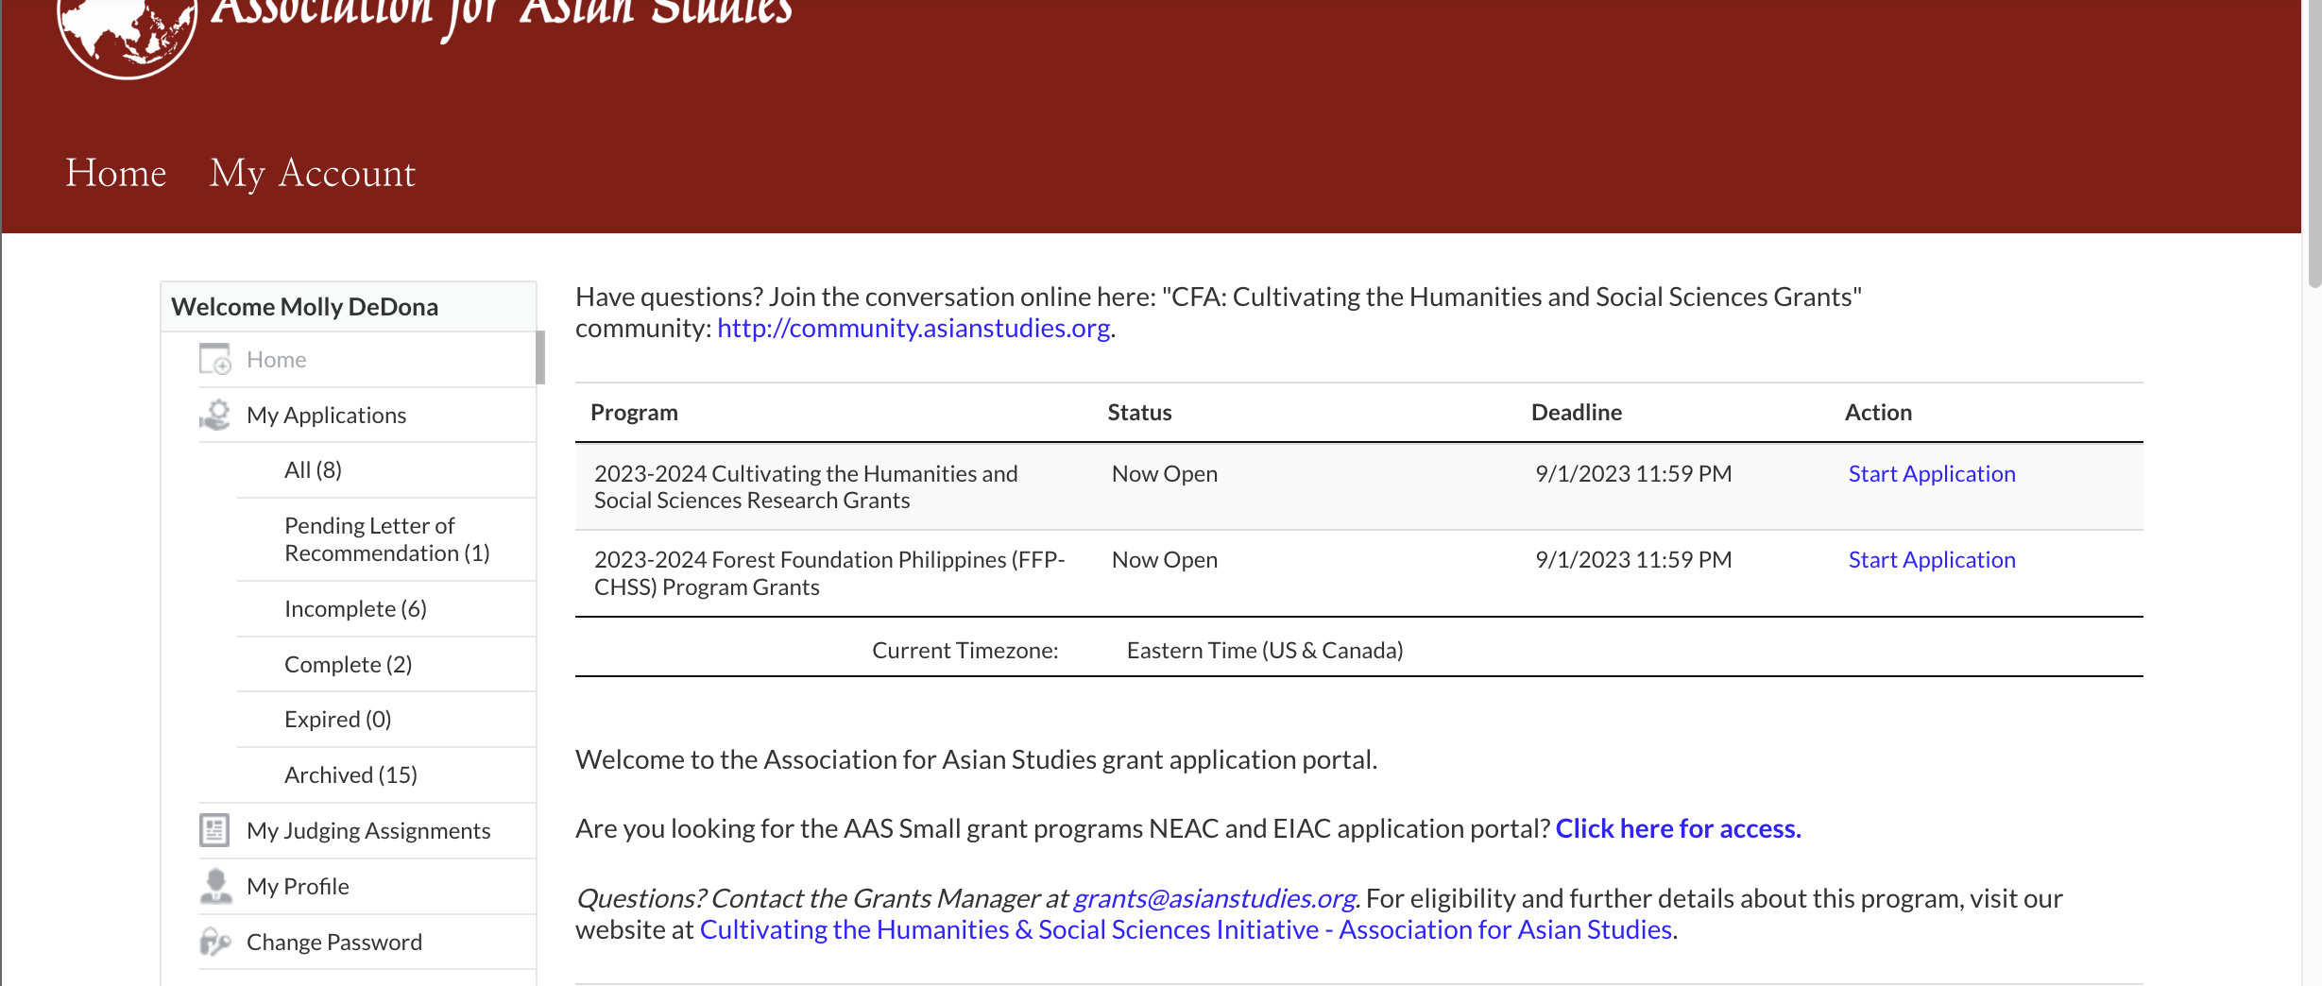
Application portal
How to Apply Guide:
https://www.asianstudies.org/wp-content/uploads/Step-by-Step-instructions-on-how-to-apply-for-a-CHSS-grant-English.pdf
Application Portal link:
https://asianstudies.secure-platform.com/a/organizations/main/home

Slide 16
What is required for an application?
Read the CFA in 8 languages:
Bisaya, Hindi, Khmer, Lao, Tagalog, Tetun, Urdu, and Vietnamese.
A short cover letter
A two-page curriculum vitae (CV) in English
An 800-1,000 word research project proposal (including footnotes)
A budget of your project
A sample of the applicant’s writing work (no minimum length, but ideally 2,000 – 2,500 words)
A list of any other research grants you have previously received.
A timeline (as short as 2 months, or as long as 12 months).
Short term grants are defined as less than 4 months, and long term grants are 5 – 7 months and long term grants are 8-12 months in duration.
One recommendation letter by a referee, who is familiar with the applicant’s field of research.
Preference will be given to applicants who have never received a research grant in the past and/or who are based in an under-resourced institution. Each applicant must request that the letters be submitted via the online portal by September 1, 2023.
The grants will be awarded with the understanding that within two years of completion of their project, the recipients will present the results of their research at an AAS-in-Asia conference, or a similar international conference, with acknowledgment of the award. Any publication based on the funded research should also acknowledge the AAS-Sweden Cultivating the Humanities and Social Sciences Research Grants or the Forest Foundation Philippines.

Slide 17
Questions?
Read about Frequently asked questions here: Cultivating the Humanities & SocialSciences Initiative -FAQ
Post your questions on the Community Forum – JOIN NOW!

